Slide 1



credit card dashboard
View in Power BI
Last data refresh:
8/3/2024 6:57:35 PM UTC
Downloaded at:
8/3/2024 7:00:34 PM UTC

Slide 2
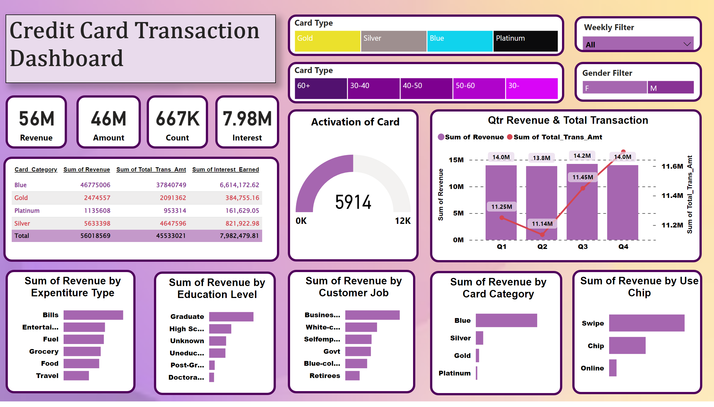
Page 2
Notes:
textbox
No alt text provided
Qtr Revenue & Total Transaction
No alt text provided
Sum of Revenue by Expentiture Type
No alt text provided
Sum of Revenue by Education Level
No alt text provided
Sum of Revenue by Customer Job
No alt text provided
Sum of Revenue by Use Chip
No alt text provided
Sum of Revenue by Card Category
No alt text provided
tableEx
No alt text provided
card
No alt text provided
card
No alt text provided
card
No alt text provided
card
No alt text provided
slicer
No alt text provided
Gender Filter
No alt text provided
Card Type
No alt text provided
Card Type
No alt text provided
Activation of Card
No alt text provided

